Slide 1
4.3 Ito’s Integral for General Integrands
報告者：陳政岳

Slide 2
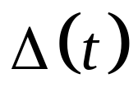
Define the Ito’s integral for integrands that are allowed to vary continuously with time and also to jump.
The continuously varying is shown as a solid line and the approximating simple integrand is dashed.

Slide 3
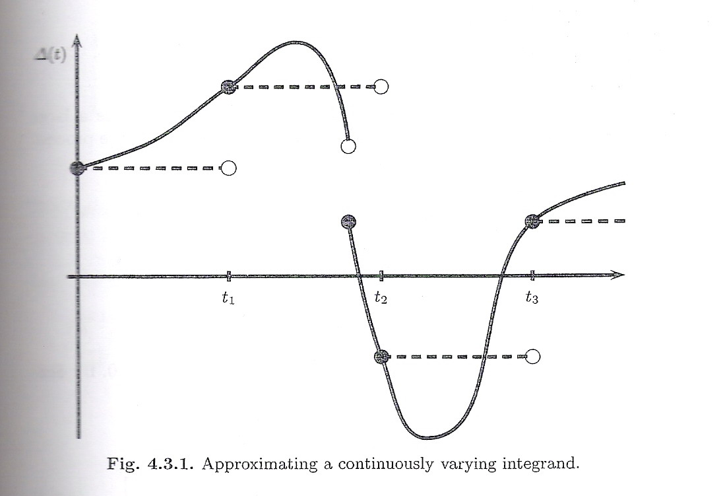

Slide 4
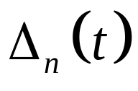

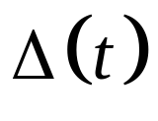
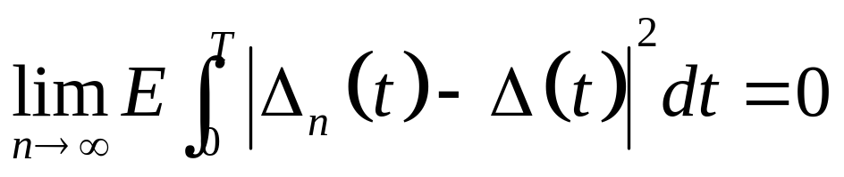
In general, it is possible to choose a sequence
of simple processes such that as these processes converge to the continuously varying .
By “converge”, we mean that

Slide 5
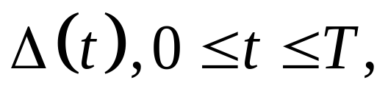
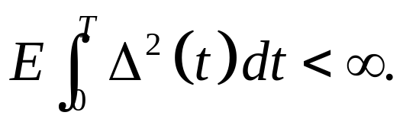
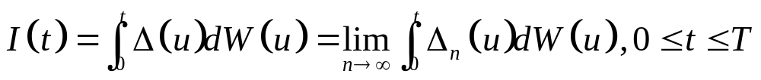
Theorem 4.3.1 Let T be a positive constant and let be adapted to the filtration F(t) and be an adapted stochastic process that satisfies Then
has the following properties.
(1)(Continuity) As a function of the upper limit of integration t, the paths of I(t) are continuous.
(2)(Adaptivity)For each t, I(t) is F(t)-measurable.

Slide 6
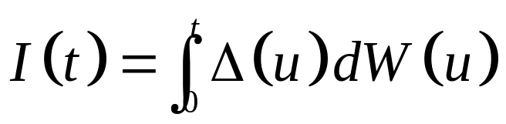
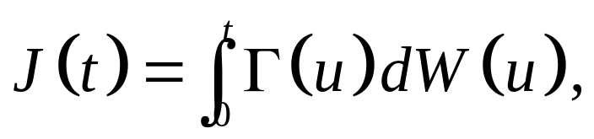
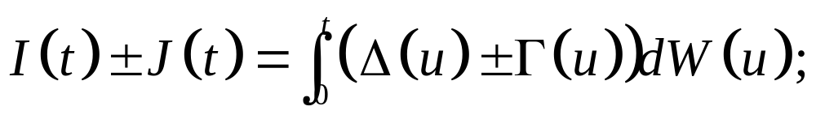
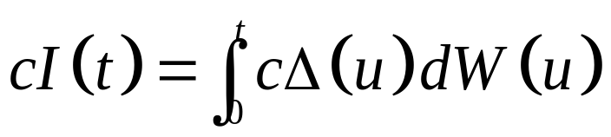
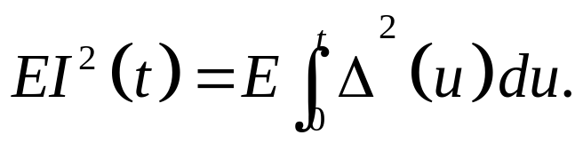
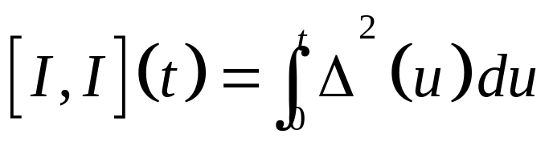
(3)(Linearity) If and
then
furthermore, for every constant c,
(4)(Martingale) I(t) is a martingale.
(5)(Ito isometry)
(6)(Quadratic variation)

Slide 7
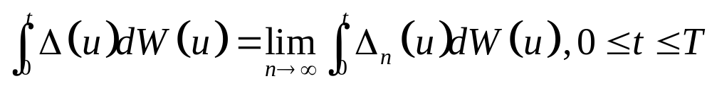
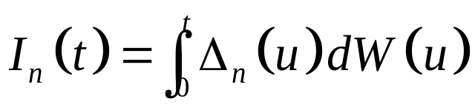
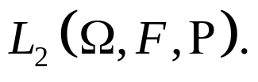
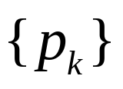
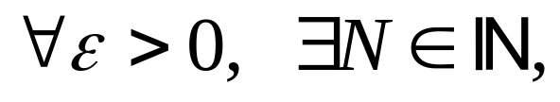
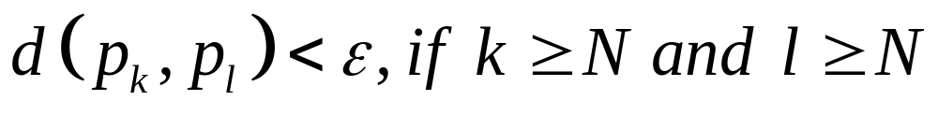
To explain Ito integrand by Cauchy sequence
The limit exists because is a Cauchy sequence in
Cauchy sequence：
Let X be a metric space. There is a sequence in X.
such that
Called is a Cauchy sequence.

Slide 8
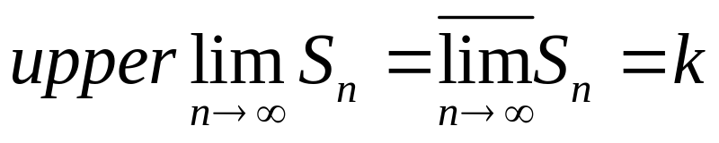
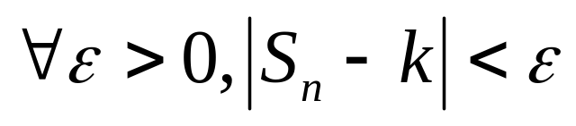
So, a metric space X is said to be complete provided that every Cauchy sequence in X converges to a point in X.
For instance, if X is the subsapce of R consisting of the interval (0,2). Taking the sequence {1/k} is a Cauchy sequence in X that does not converge to a point in X, since it converge to the point 0, then X is not complete.
Upper limit：
An upper limit of a series
is said to exist if , for infinitely many values of n and if no number larger than k has this property.

Slide 9
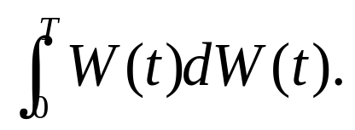
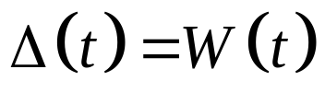
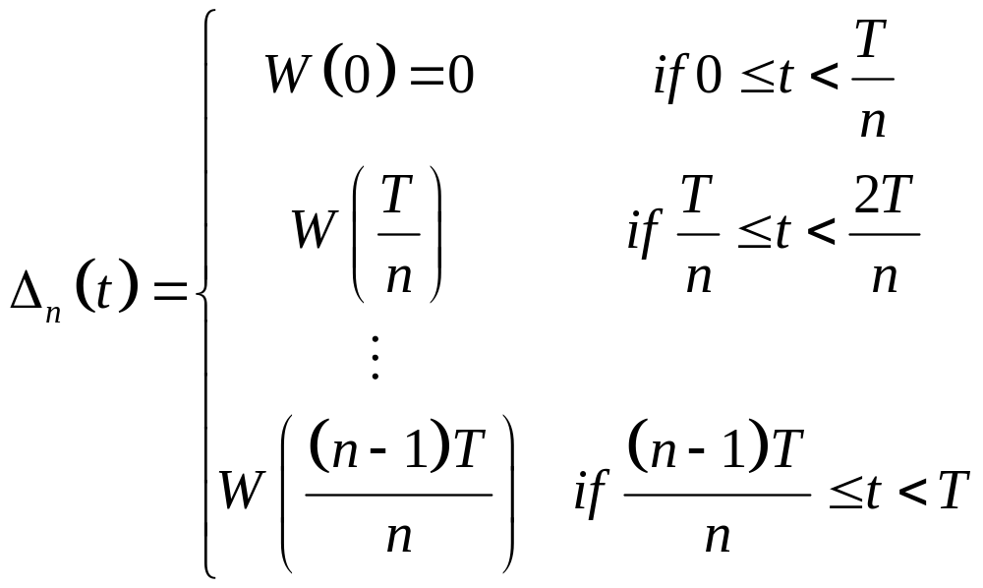
Example 4.3.2 Computing We choose a large integer n and approximate the integrand by the simple process

Slide 10
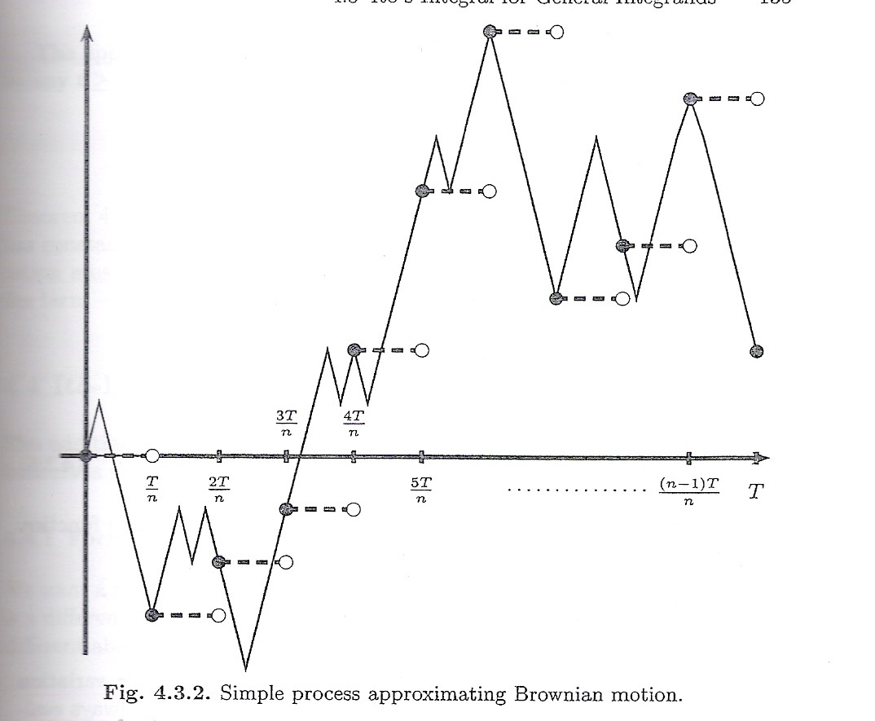

Slide 11
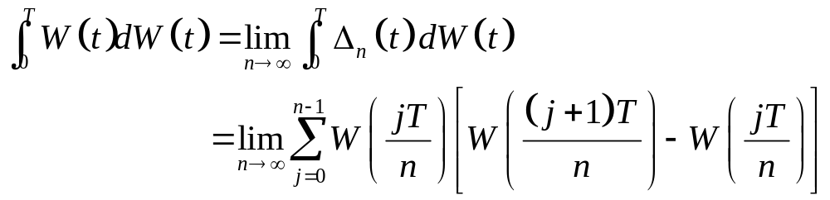
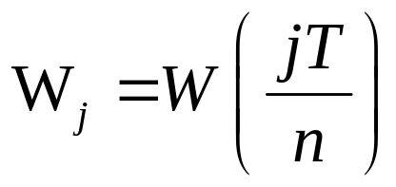
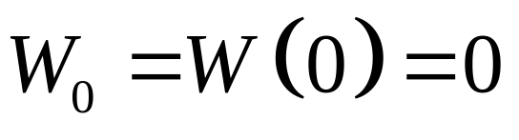
By definition
Let and

Slide 12
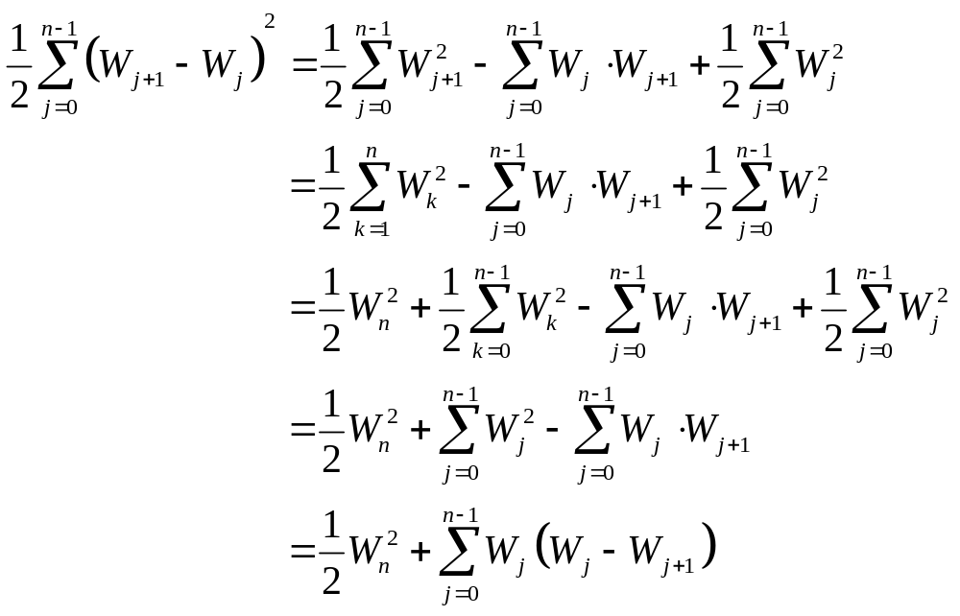

Slide 13
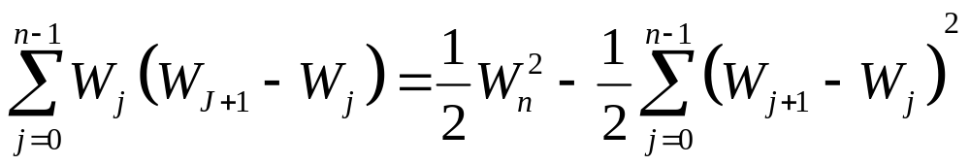
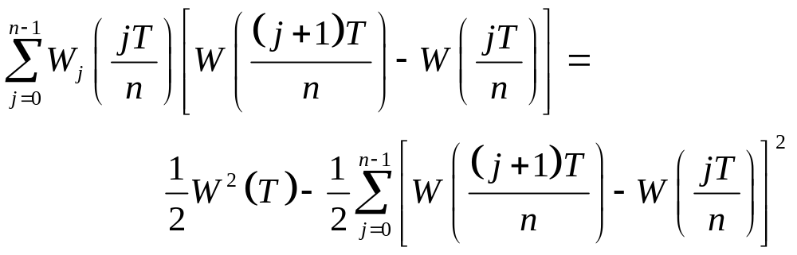
Conclude that
In the original notation

Slide 14

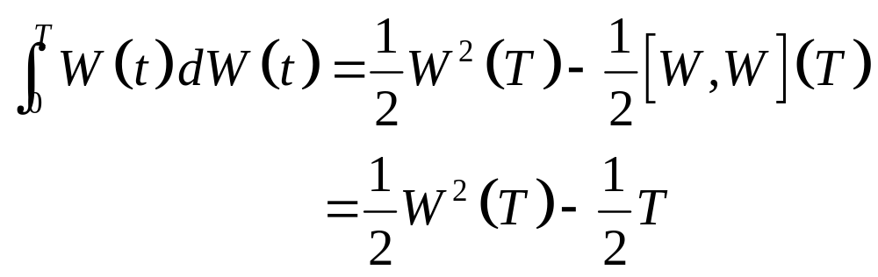
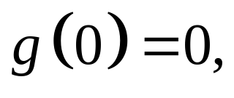
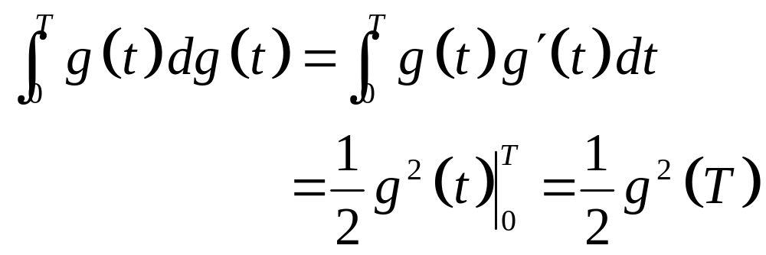
Letting
By ordinary calculus. If g is a differentiable function with then

Slide 15
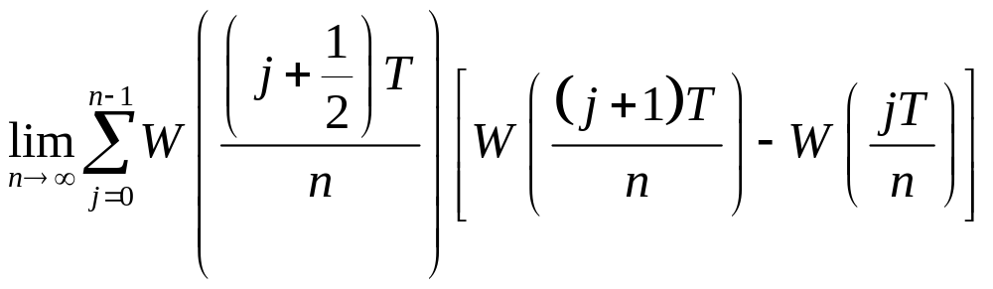
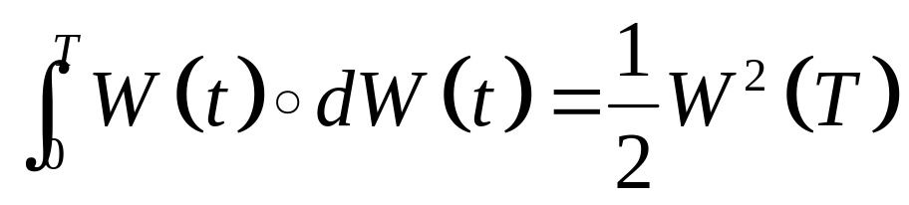
Usually, evaluating the integrand at the left-hand endpoint of the subinterval.
If evaluating the integrand at the midpoint,
then ( see Exercise 4.4 )

Slide 16
is called the Stratonovich integral.
Stratonovich integral is inappropriate for finance.
In finance, the integrand represents a position in an asset and the integrator represents the price of that asset.
The difference of the Stratonovich integral and the Ito integrand is sensitive. Stratonovich integral is less sensitive than Ito integrand.

Slide 17
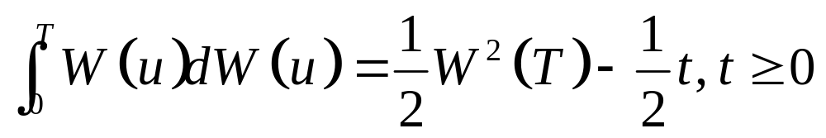
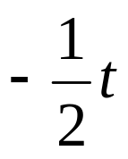
The upper limit of integrand T is arbitrary, then
By Theorem4.3.1
At t = 0, this martingale is 0 and its expectation is 0.
At t > 0, if the term is not present and EW²(t) = t, it is not martingale.

